Slide 1
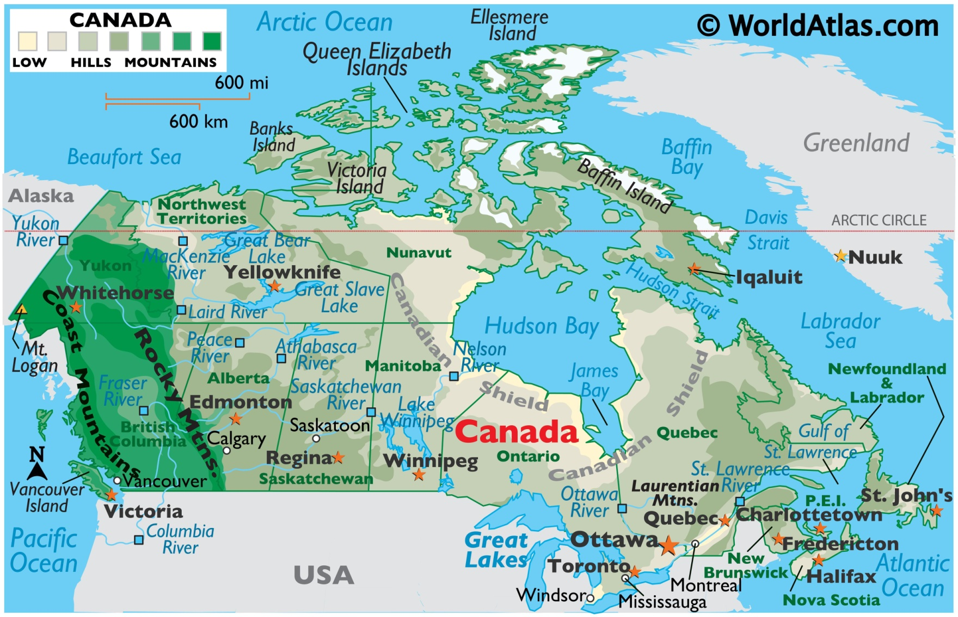

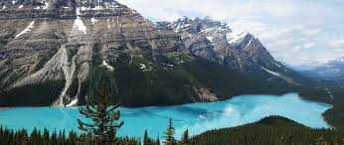
Canada
April 11-14

Slide 2
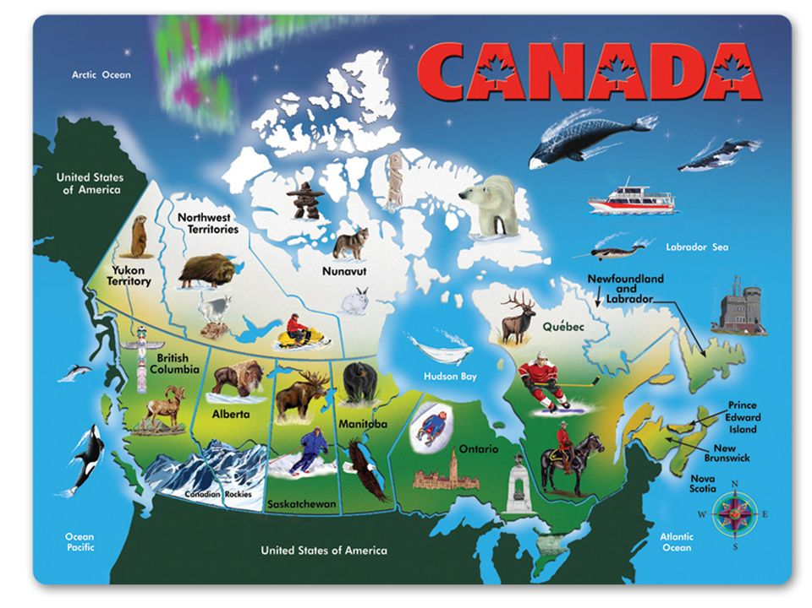

Slide 3
SS6H2 Describe Quebec’s independence movement.
SS6CG2 Explain citizen participation in the Canadian government. a. Explain the role of citizens in choosing the leader of Canada (parliamentary democracy)

Slide 4
SS6G4 Locate selected features of Canada.
Locate on a world and regional political-physical map: the St. Lawrence River, Hudson Bay, Atlantic Ocean, Pacific Ocean, the Great Lakes, Canadian Shield, and Rocky Mountains.
b. Locate on a world and regional political-physical map Canada and the province of Quebec.
SS6G5 Explain the impact of location, climate, distribution of natural resources, and population distribution on Canada.
a. Describe how Canada’s location, climate, and natural resources impact trade and affect where people live.
SS6G6 Explain the impact of environmental issues in Canada.
a. Explain the causes and effects of pollution and acid rain in Canada to include the Great Lakes.
b. Explain the causes and effects of the extraction of natural resources on the Canadian Shield (e.g., mining and logging).

Slide 5
 | Monday 10 | Tuesday 11 | Wednesday 12 | Thursday 13 | Friday 14
Focus Standard(s) | No School | SS6G4 | SS6G5,6 | SS6G5,G6 | SS6H2
Learning Target(s) |  | Locate Select Features of Canada | Climate, Resources, Environmental Issues | Climate, Resources, Environmental Issues | Quebec’s Independence
Opening |  | Canada Map with partner | Canada Map(Practice) | Canada Map with partner | Canada Map(Practice)
Work Session |  | Textbook Chapter 10 Pages 228-252 | Textbook Chapter 10 Pages 228-252 | Textbook Chapter 10 Pages 228-252 | Textbook Chapter 10 Pages 228-252
Closing |  |  | TOD | Think-Pair-Share | Group Discussion
Minor Assignments Due
Major Assignments Due
Current Relearning & Reassessment Assignments (with due dates) |  | Continue to have students study and complete any missing graded assignments
Vocabulary
Upcoming Major Assignments

Slide 6
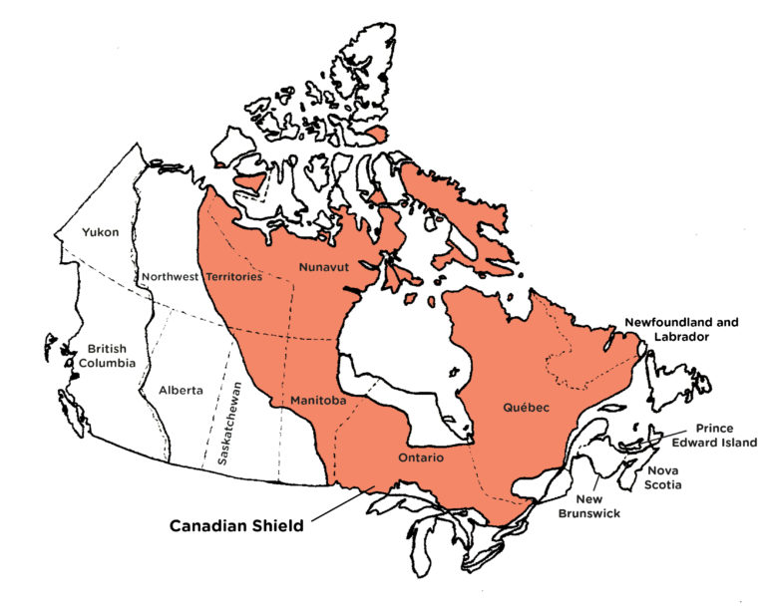
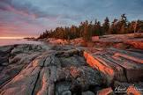

The Canadian Shield
Video: Canadian Shield
Various minerals and precious stones have been mined or continue to be mined on the Shield, including gold, silver, copper, zinc, nickel, iron, uranium and diamonds. The first modern hard-rock mine in the Canadian Shield, near Madoc, Ontario, opened in 1866 after gold was found there.

Slide 7


Slide 8
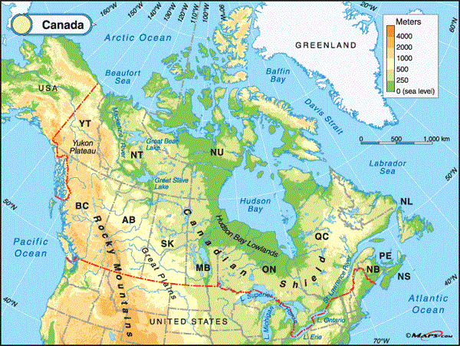
Locate on a world and regional political-physical map: the St. Lawrence River, Hudson Bay, Atlantic Ocean, Pacific Ocean, the Great Lakes, Canadian Shield, and Rocky Mountains.

Slide 9
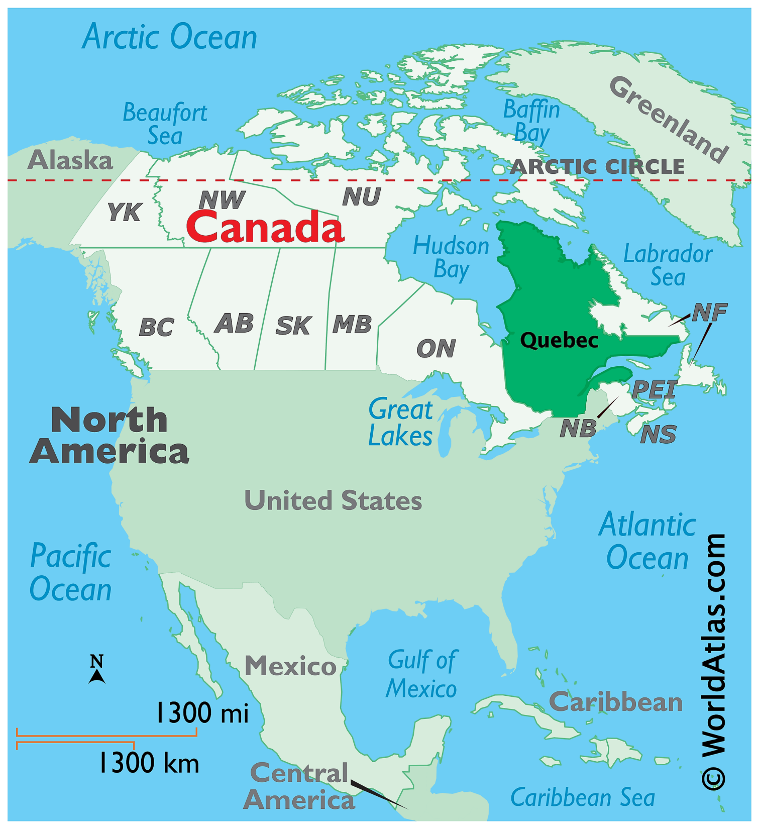
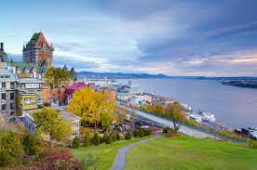
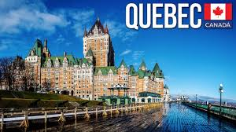

Slide 10
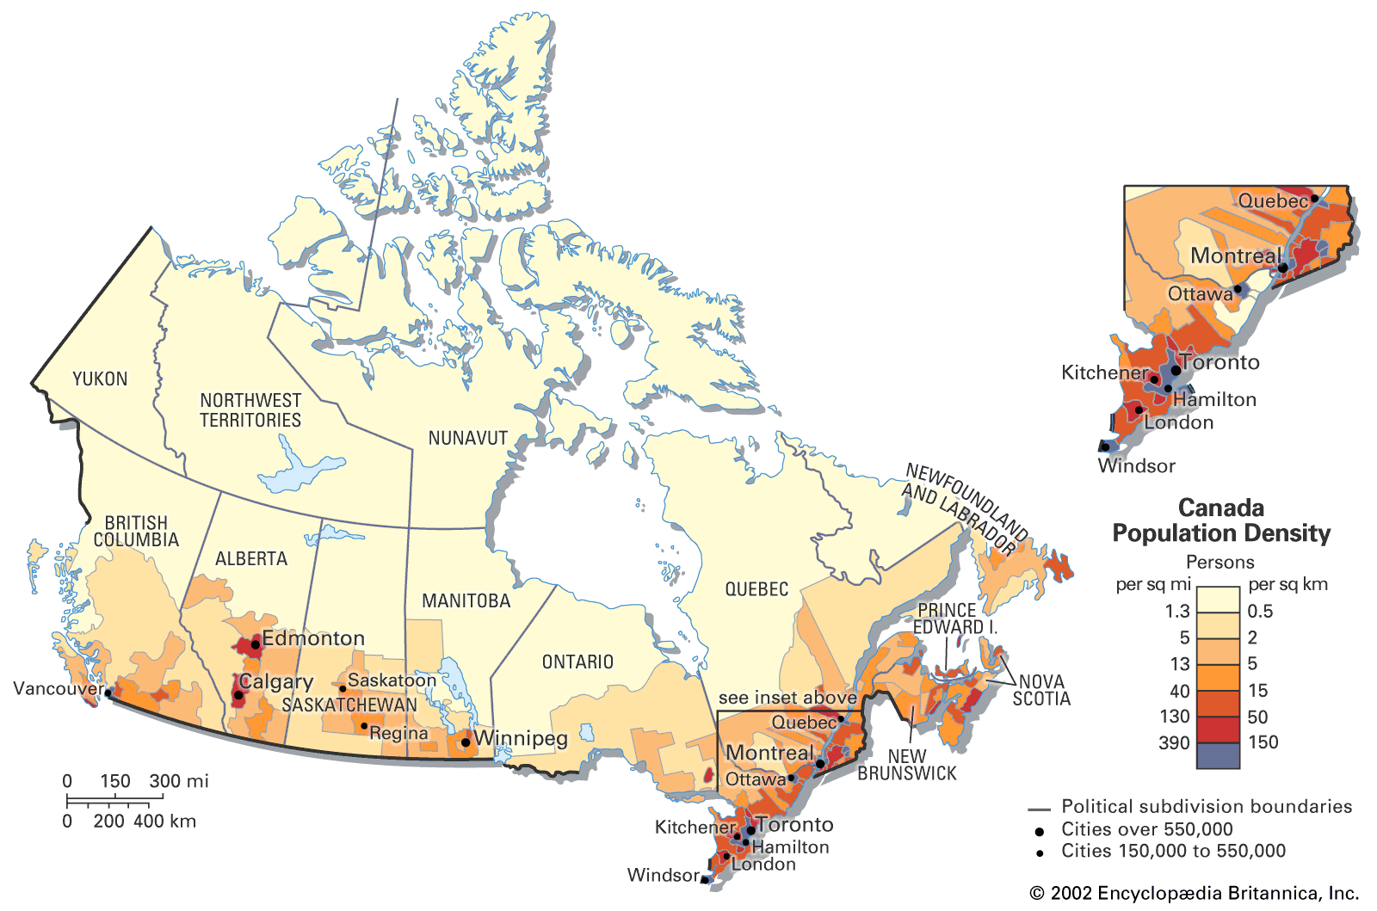
Population:
Where people located

Slide 11
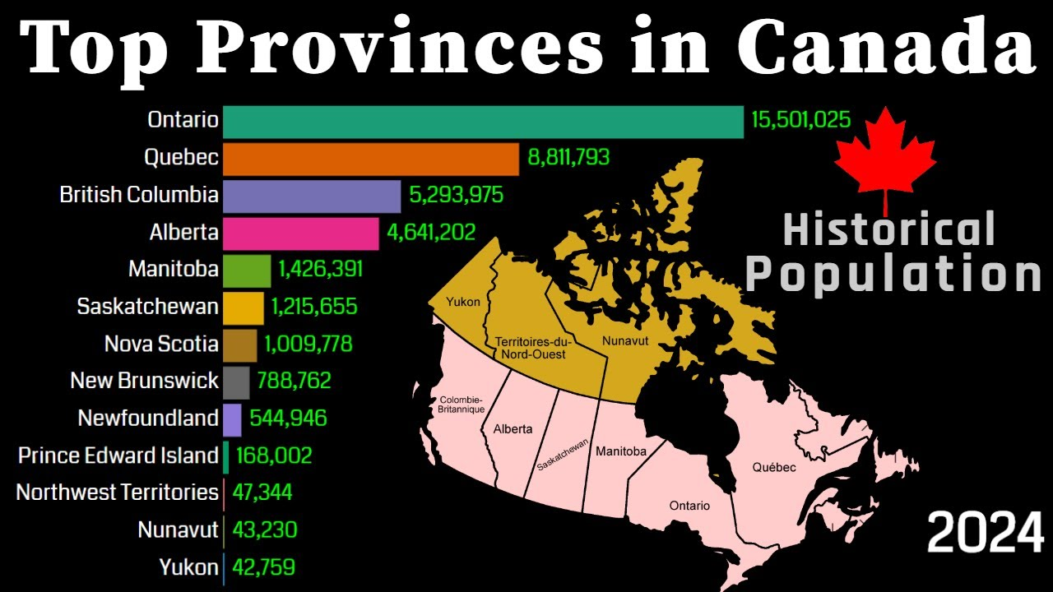

Slide 12
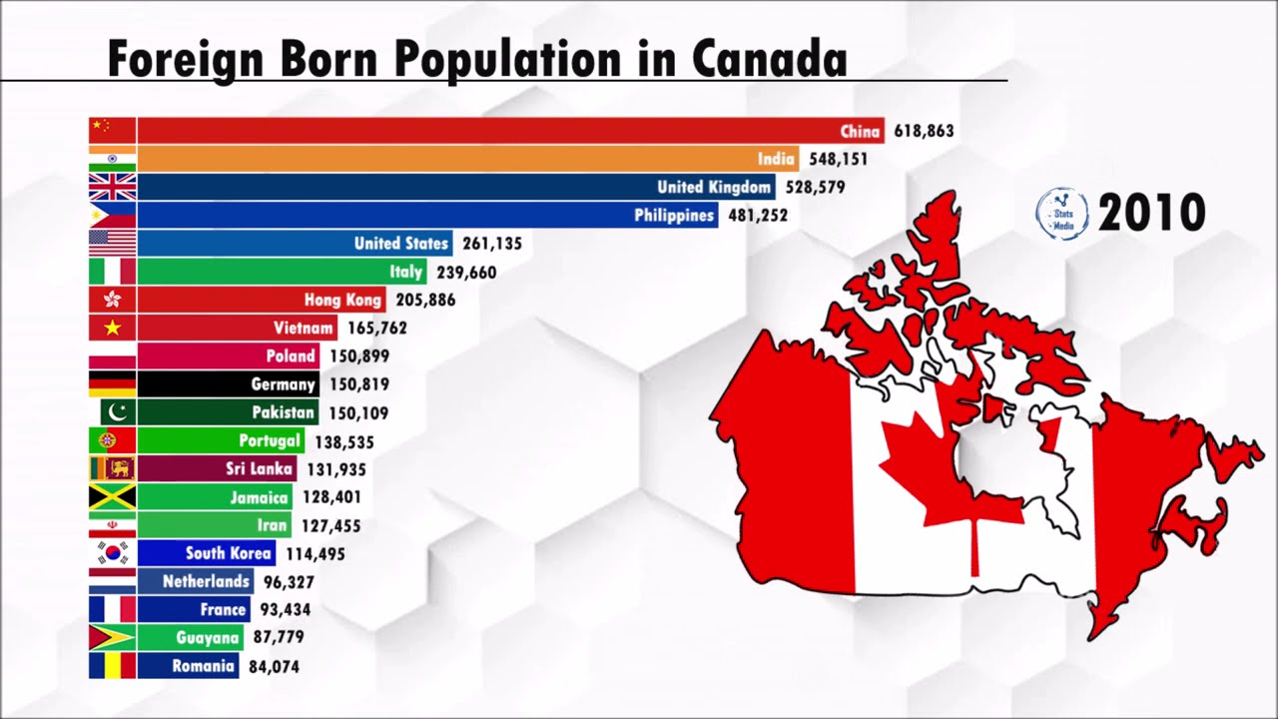

Slide 13
